Slide 1
TRAVALLER’S HUB
Name : SOORAJ.M
ROLL NO : 53
Product Owner : Ms.Febin Aziz

Slide 2
TABLE OF CONTENTS
Introduction
Modules
Data Flow Diagram
Table Design
Developing Environment
Product Backlog
User Stories
Project Plan
Sprint Plan
Sprint Actual

Slide 3
TRAVELLER’S HUB
Here we introduce a social media platform for those who love travel. This web application allows users to create a room for discussion and planning for the trip to a particular destination, if any other user is also interested and planning for the same destination, then that person can join in this room. This platform brings a new way of connecting new people of our mentality. In this web application, the user should specify their way of transport which distinguishes them from others, and show only those rooms with the same transportation system.
This web application will allow users to connect with new people of their kind of mentality. Through this system we can reduce our effort through our trip, as we move in the group which will have all members of that room, things become easy to manage and overcome difficulties.

Slide 4
MODULES
USER (Admin Of the Room)
Register
Login
Create Room
View Request
Manage Request
View Feedback
Chat
Share Content
View content
Delete Room
Remove Members
USER (Member of the Room)
Register
Login
Search Room
Send Request
View Request Response
Chat
Share Content
View Content
Add Feedback
Exit Room

Slide 5
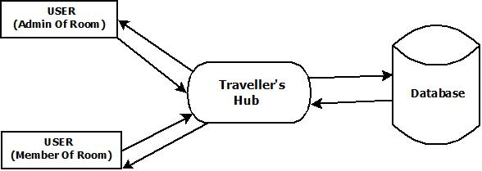
DATA FLOW DIAGRAM
LEVEL 0

Slide 6
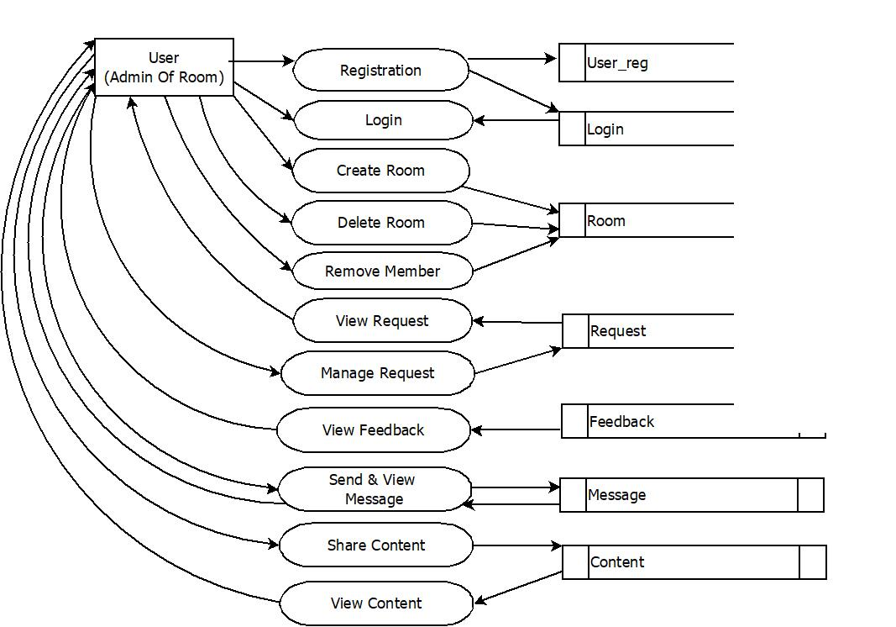
DATA FLOW DIAGRAM
LEVEL 1

Slide 7
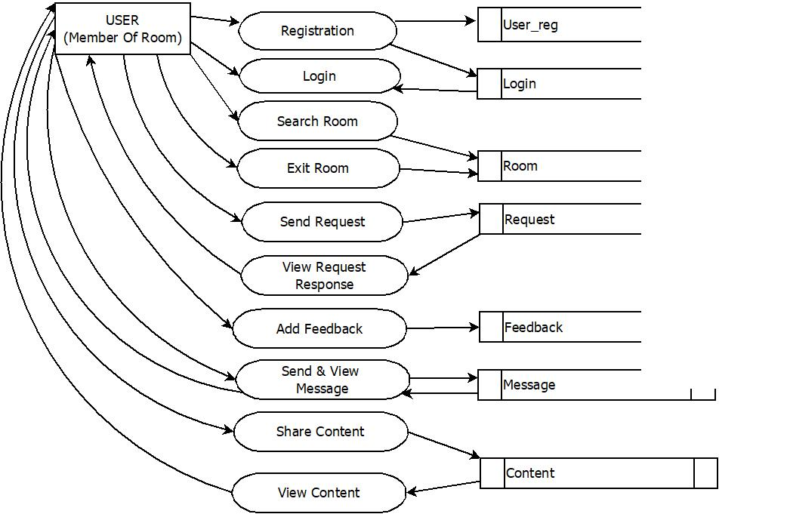
DATA FLOW DIAGRAM
LEVEL 2

Slide 8
DEVELOPING ENVIRONMENT
Front-End : HTML,CSS Java Script
Back-End : Python , Django
Database : Mysql
IDE : Pycharm
Operating System : Windows 10
Processor : Intel Core i5
RAM : 8 GB

Slide 9
PRODUCT BACKLOG
User Story ID | Priority <High/Medium/Low> | Size (Hours) | Sprint <#> | Status <Planned/In Progress/Completed> | Release Date | Release Goal
1 | Medium | 4 | 1 | Completed | 15/11/2021 | Creation Of Registration Page
2 | Medium | 4 |  | Completed | 17/11/2021 | Creation Of Login Page
3 | High | 5 | 2 | Planned | 22/11/2021 | Create Room
4 | High | 4 |  | Planned | 24/11/2021 | Requesting to Join Room
5 | High | 5 |  | Planned | 29/11/2021 | Accessing Room
6 | Medium | 4 |  | Planned | 01/12/2021 | Content Sharing
7 | Medium | 4 | 3 | Planned | 13/12/2021 | Communication Among User
8 | Medium | 4 |  | Planned | 17/01/2022 | Feedback From User
9 | Medium | 4 |  | Planned | 24/01/2022 | Admin View Feedback
10 | High | 4 | 4 | Planned | 02/02/2022 | Leave Room
11 | Medium | 4 |  | Planned | 07/02/2022 | Remove Member
12 | High | 4 |  | Planned | 14/02/2022 | Remove Room

Slide 10
USER STORY
User Story ID | As a<type of user> | I want to <perform some task> | So that I can <achieve some goal>
1 | User | Registration | Access Login
2 | User | Login | Access Home Page
3 | User | Select Vehicle & Destination | Create Room As Admin
4 | User | Send Request | View Response
5 | User | Manage Request | Approve/Decline Request
6 | User | Add Content | Share with Members
7 | User | Send Message | Communicate with other Members
8 | User | Add Feedback | Share Experience
9 | User | View Feedback | Improve Experience
10 | User | Delete Room | Exit Room
11 | User | Remove Member | Manage Member Count
12 | User | Remove Room | Make It No More Available

Slide 11
PROJECT PLAN
User Story ID | Task Name | Start Date | End Date | Days | Status
1 | Sprint 1 | 15/11/2021 | 15/11/2021 | 2 | Completed
2 |  | 17/11/2021 | 17/11/2021 |  | Completed
3 | Sprint 2 | 22/11/2021 | 22/11/2021 | 4 | Planned
4 |  | 24/11/2021 | 24/11/2021 |  | Planned
5 |  | 29/11/2021 | 29/11/2022 |  | Planned
6 |  | 01/12/2021 | 01/12/2021 |  | Planned
7 | Sprint 3 | 13/12/2021 | 13/12/2021 | 3 | Planned
8 |  | 17/01/2022 | 17/01/2022 |  | Planned
9 |  | 24/01/2022 | 24/01/2022 |  | Planned
10 | Sprint 4 | 02/02/2022 | 02/02/2022 | 3 | Planned
11 |  | 07/02/2022 | 07/02/2022 |  | Planned
12 |  | 14/02/2022 | 14/02/2022 |  | Planned

Slide 12
SPRINT BACKLOG PLAN
Backlog Item | Status and Completion date | Original Estimate in hours | Day 1 | Day 2 | Day 3 | Day 4 | Day 5 | Day 6 | Day 7 | Day 8 | Day 9 | Day 10 | Day 11 | Day 12 | Day 13
User story #1,2 |  |  | Hours | Hours | Hours | Hours | Hours | Hours | Hours | Hours | Hours | Hours | Hours | Hours | Hours
UI Designing | 15/11/21 | 2 | 2 | 0 | 0 | 0 | 0 | 0 | 0 | 0 | 0 | 0 | 0 | 0 | 0
Database Connectivity | 17/11/21 | 2 | 0 | 2 | 0 | 0 | 0 | 0 | 0 | 0 | 0 | 0 | 0 | 0 | 0
Coding | 17/11/21 | 2 | 0 | 2 | 0 | 0 | 0 | 0 | 0 | 0 | 0 | 0 | 0 | 0 | 0
Testing | 17/11/21 | 2 | 0 | 2 | 0 | 0 | 0 | 0 | 0 | 0 | 0 | 0 | 0 | 0 | 0
User story #3,4,5,6
UI Designing | 22/11/21 | 5 | 0 | 0 | 5 | 0 | 0 | 0 | 0 | 0 | 0 | 0 | 0 | 0 | 0
Database Connectivity | 24/11/21 | 3 | 0 | 0 | 0 | 3 | 0 | 0 | 0 | 0 | 0 | 0 | 0 | 0 | 0
Coding | 01/12/21 | 6 | 0 | 0 | 0 | 0 | 6 | 0 | 0 | 0 | 0 | 0 | 0 | 0 | 0
Testing | 01/12/21 | 4 | 0 | 0 | 0 | 0 | 4 | 0 | 0 | 0 | 0 | 0 | 0 | 0 | 0
User story #7,8,9
UI Designing | 13/12/21 | 4 | 0 | 0 | 0 | 0 | 0 | 4 | 0 | 0 | 0 | 0 | 0 | 0 | 0
Database Connectivity | 17/01/22 | 3 | 0 | 0 | 0 | 0 | 0 | 3 | 0 | 0 | 0 | 0 | 0 | 0 | 0
Coding | 24/01/22 | 3 | 0 | 0 | 0 | 0 | 0 | 0 | 3 | 0 | 0 | 0 | 0 | 0 | 0
Testing | 24/01/22 | 2 | 0 | 0 | 0 | 0 | 0 | 0 | 0 | 2 | 0 | 0 | 0 | 0 | 0
User story #10,11,12
UI Designing | 02/02/22 | 4 | 0 | 0 | 0 | 0 | 0 | 0 | 0 | 0 | 4 | 0 | 0 | 0 | 0
Database Connectivity | 02/02/22 | 2 | 0 | 0 | 0 | 0 | 0 | 0 | 0 | 0 | 0 | 2 | 0 | 0 | 0
Coding | 07/02/22 | 3 | 0 | 0 | 0 | 0 | 0 | 0 | 0 | 0 | 0 | 0 | 3 | 0 | 0
Testing | 14/02/22 | 3 | 0 | 0 | 0 | 0 | 0 | 0 | 0 | 0 | 0 | 0 | 3 | 0 | 0
Total |  | 50 | 2 | 6 | 5 | 3 | 10 | 7 | 3 | 2 | 4 | 2 | 6 | 0 | 0

Slide 13
SPRINT BACKLOG ACTUAL
Backlog Item | Status and Completion date | Original Estimate in hours | Day 1 | Day 2 | Day 3 | Day 4 | Day 5 | Day 6 | Day 7 | Day 8 | Day 9 | Day 10 | Day 11 | Day 12 | Day 13 | Completed <Y/N>
User story #1,2 |  |  | Hours | Hours | Hours | Hours | Hours | Hours | Hours | Hours | Hours | Hours | Hours | Hours | Hours
UI Designing | 15/11/21 | 2 | 2 | 0 | 0 | 0 | 0 | 0 | 0 | 0 | 0 | 0 | 0 | 0 | 0 | Y
Database Connectivity | 17/11/21 | 2 | 0 | 2 | 0 | 0 | 0 | 0 | 0 | 0 | 0 | 0 | 0 | 0 | 0 | Y
Coding | 17/11/21 | 2 | 0 | 2 | 0 | 0 | 0 | 0 | 0 | 0 | 0 | 0 | 0 | 0 | 0 | Y
Testing | 17/11/21 | 2 | 0 | 2 | 0 | 0 | 0 | 0 | 0 | 0 | 0 | 0 | 0 | 0 | 0 | Y
User story #3,4,5,6
UI Designing | 22/11/21 | 5 | 0 | 0 | 5 | 0 | 0 | 0 | 0 | 0 | 0 | 0 | 0 | 0 | 0 | N
Database Connectivity | 14/11/21 | 3 | 0 | 0 | 0 | 3 | 0 | 0 | 0 | 0 | 0 | 0 | 0 | 0 | 0 | N
Coding | 01/12/21 | 6 | 0 | 0 | 0 | 0 | 6 | 0 | 0 | 0 | 0 | 0 | 0 | 0 | 0 | N
Testing | 01/12/21 | 4 | 0 | 0 | 0 | 0 | 4 | 0 | 0 | 0 | 0 | 0 | 0 | 0 | 0 | N
User story #7,8,9
UI Designing | 13/12/21 | 4 | 0 | 0 | 0 | 0 | 0 | 4 | 0 | 0 | 0 | 0 | 0 | 0 | 0 | N
Database Connectivity | 17/01/22 | 3 | 0 | 0 | 0 | 0 | 0 | 3 | 0 | 0 | 0 | 0 | 0 | 0 | 0 | N
Coding | 24/01/22 | 3 | 0 | 0 | 0 | 0 | 0 | 0 | 3 | 0 | 0 | 0 | 0 | 0 | 0 | N
Testing | 24/01/22 | 2 | 0 | 0 | 0 | 0 | 0 | 0 | 0 | 2 | 0 | 0 | 0 | 0 | 0 | N
User story #10,11,12
UI Designing | 02/02/22 | 4 | 0 | 0 | 0 | 0 | 0 | 0 | 0 | 0 | 4 | 0 | 0 | 0 | 0 | N
Database Connectivity | 02/02/22 | 2 | 0 | 0 | 0 | 0 | 0 | 0 | 0 | 0 | 0 | 2 | 0 | 0 | 0 | N
Coding | 07/02/22 | 3 | 0 | 0 | 0 | 0 | 0 | 0 | 0 | 0 | 0 | 0 | 3 | 0 | 0 | N
Testing | 14/02/22 | 3 | 0 | 0 | 0 | 0 | 0 | 0 | 0 | 0 | 0 | 0 | 3 | 0 | 0 | N
Total |  | 50 | 2 | 6 | 5 | 3 | 10 | 7 | 3 | 2 | 4 | 2 | 6 | 0 | 0 | N

